Slide 1


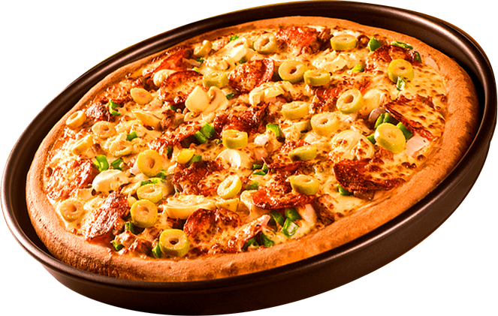

About
Contact
SQL PROJECT ON PIZZA SALES

Slide 2
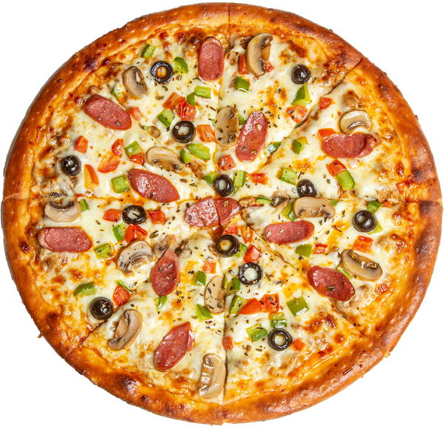

Home
About
Contact
HELLO!
Hello, My name is Sayli Munde . In this project i have utilize SQL queries to solve questions that were related to pizzas sales

Slide 3
PROJECT OVERVIEW
Home
About
Contact
This project focuses on analyzing pizza sales data using SQL to extract meaningful business insights.
The analysis is based on 21,350 total orders, generating a total revenue of ₹817,860 from pizza sales.

Slide 4
OBJECTIVE
Home
About
Contact
To evaluate restaurant sales performance by analyzing order volume, revenue contribution, popular pizza types, and customer ordering patterns using SQL.

Slide 5
TABLES USED
Home
About
Contact
DATABASE TABLES USED
orders – order_id, order_date,order_time
order_details – order_id, pizza_id, quantity
pizzas – pizza_id, size, price
pizza_types – pizza_type, category, name

Slide 6
TOOLS & SKILLS
Home
About
Contact
TOOLS & SKILLS USED
SQL (SELECT, WHERE, GROUP BY, JOIN, ORDER BY)
Aggregate functions (COUNT, SUM, AVG)
Date & Time functions
Business problem-solving
Data analysis and interpretation

Slide 7
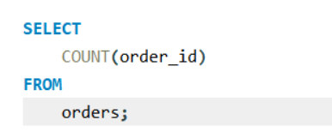
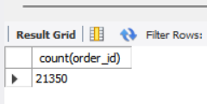
RETRIEVE THE TOTAL NUMBER OF ORDERS PLACED.
Home
About
Contact

Slide 8
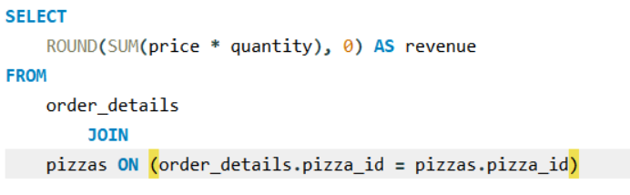

CALCULATE THE TOTAL REVENUE GENERATED FROM PIZZA SALES.
Home
About
Contact

Slide 9
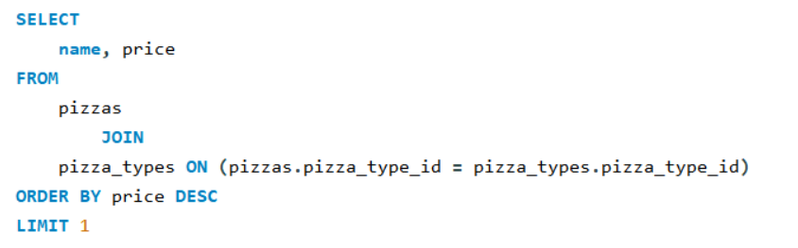
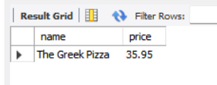
IDENTIFY THE HIGHEST-PRICED PIZZA.
Home
About
Contact

Slide 10
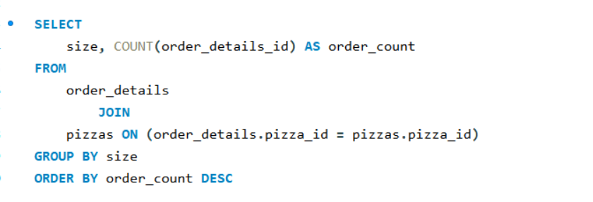
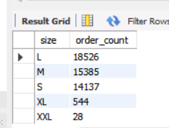
IDENTIFY THE MOST COMMON PIZZA SIZE ORDERED.
Home
About
Contact

Slide 11
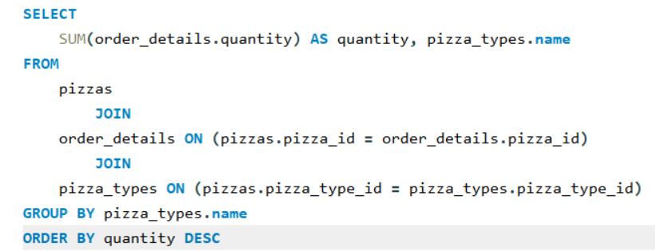
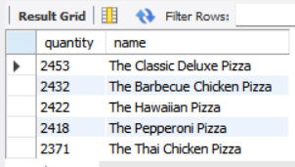
LIST THE TOP 5 MOST ORDERED
pizza types along with their quantities.
Home
About
Contact

Slide 12
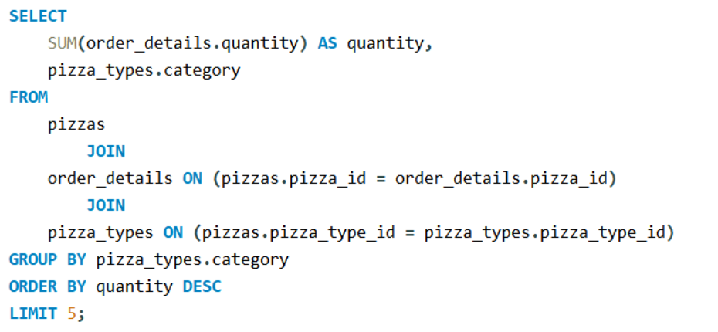
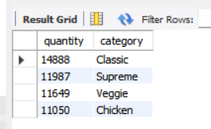
JOIN THE NECESSARY TABLES TO FIND THE TOTAL QUANTITY OF EACH PIZZA CATEGORY ORDERED.
Home
About
Contact

Slide 13
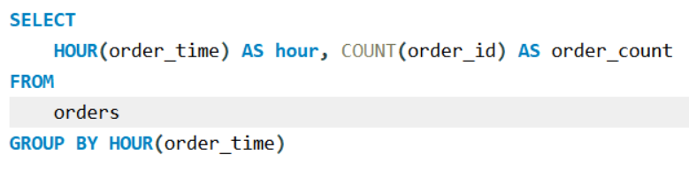
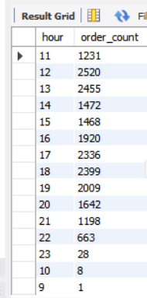
DETERMINE THE DISTRIBUTION OF ORDERS BY HOUR OF THE DAY.
Home
About
Contact

Slide 14
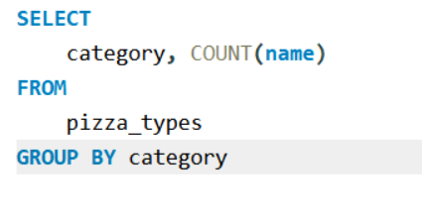
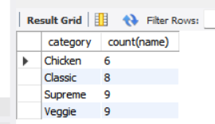
JOIN RELEVANT TABLES TO FIND
the category-wise distribution of pizzas.
Home
About
Contact

Slide 15
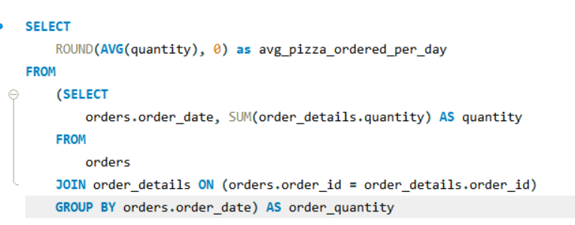

GROUP THE ORDERS BY DATE AND CALCULATE THE AVERAGE NUMBER OF PIZZAS ORDERED PER DAY.
Home
About
Contact

Slide 16
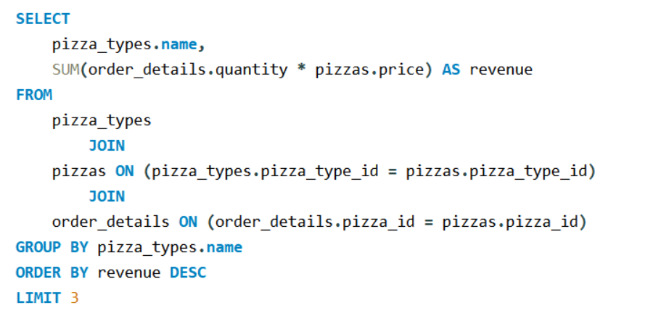
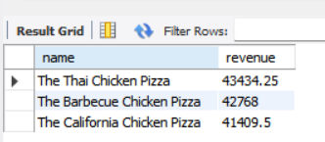
DETERMINE THE TOP 3 MOST ORDERED PIZZA TYPES BASED ON REVENUE.
Home
About
Contact

Slide 17
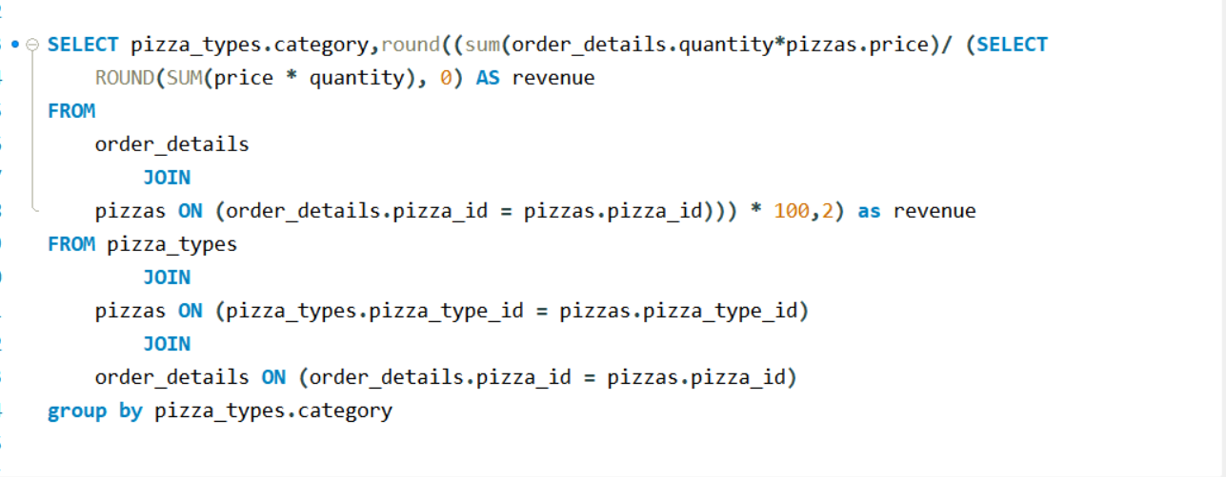
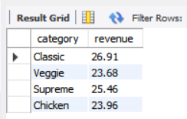
CALCULATE THE PERCENTAGE CONTRIBUTION OF EACH PIZZA TYPE TO TOTAL REVENUE.
Home
About
Contact

Slide 18
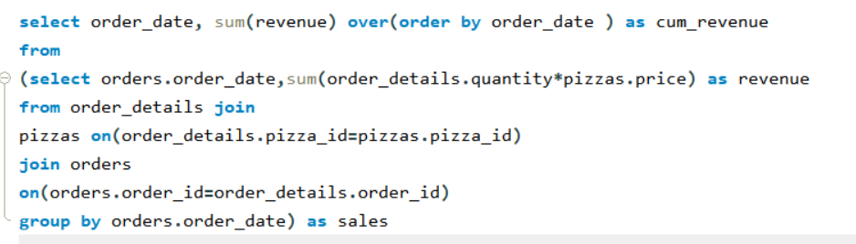
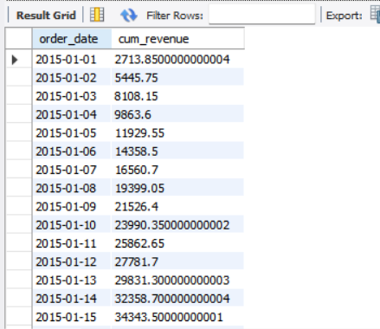
ANALYZE THE CUMULATIVE REVENUE GENERATED OVER TIME.
Home
About
Contact

Slide 19
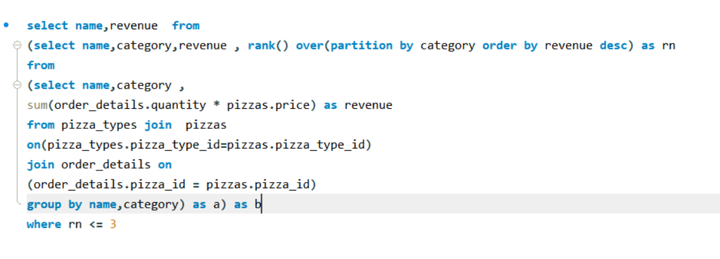
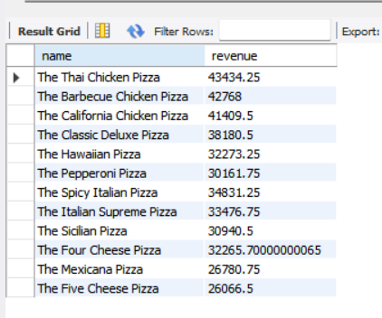
DETERMINE THE TOP 3 MOST ORDERED PIZZA TYPES based on revenue for each pizza category.
Home
About
Contact

Slide 20
KEY LEARNINGS
Home
About
Contact
Applied SQL to analyze real-world sales data
Used joins, aggregations, and window functions
Calculated revenue and percentage contribution
Identified top pizzas and category performance
Analyzed cumulative revenue trends
Converted data into business insights

Slide 21
CONCLUSION
Home
About
Contact
This project demonstrates my ability to analyze sales data using SQL and extract meaningful insights.
The analysis can help businesses improve pricing strategies, inventory management, and customer satisfaction.

Slide 22
THANK YOU
Home
About
Contact
Name: Sayli Munde
Role: Aspiring Data Analyst
Skills: SQL | Python | Power BI | Data Analysis

